Slide 1




Project EDDIE: Nutrient Loading
Castendyk, D., T. Meixner, and C.A. Gibson. 20 March 2017. Project EDDIE: Nutrient Loading. Project EDDIE Module 5, Version 1. http://cemast.illinoisstate.edu/data-for-students/modules/nutrient-loading.shtml.
Module development was supported by NSF DEB 1245707.

Slide 2
Nutrients
Nutrients are chemicals that plants and animals need to grow and survive.
Because water is a universal solvent, all life on Earth utilizes liquid water to obtain and circulate nutrients
Young men are 64% water by weight
Young women are 53% water by weight
The search for extra terrestrial life is focused on finding planets that have liquid water
For plants:
Primary macronutrients include carbon (C), nitrogen (N), phosphorous (P), and potassium (K).
Secondary macronutrients include calcium (Ca), magnesium (Mg) and sulfur (S)
Micronutrients include copper (Cu), iron (Fe), manganese (Mn), molybdenum (Mo), zinc (Zn) and nickel (Ni), and sometimes boron (B), silicon (Si), cobalt (Co).

Slide 3
Nutrients vs. Toxins
Micronutrient: a small amount is needed for biological function
Plants: Copper
Humans: Cadmium, selenium
Toxin: a chemical, physical, or biological agent that causes disease or some alteration of the normal structure and function of an organism.
Acute toxicity: Immediate impact
Chronic toxicity: Impact after a long period of exposure
When does a nutrient become a toxin???
Very few elements are toxic at all concentrations
Mercury, arsenic
For most, concentration indictates toxicity

Slide 4
Nitrogen: Nutrient or Toxin
Nitrogen is used by organisms to produce amino acids, proteins, and nucleic acids.
80% of the atmosphere is nitrogen gas (N₂)
Most plants can only take up nitrogen in two forms from soil water, making nitrogen a limiting nutrient in plant growth:
Ammonium (NH₄⁺ )
Extremely toxic to plants at high concentrations
Component of animal waste
Nitrate (NO₃⁻ )
Toxic to humans in drinking water above 10 mg/L NO₃-N
Blue baby syndrome (NO₃ binds to hemoglobin = asphyxiation)

Slide 5
The Nitrogen Cycle
Fixation: Soil bacteria, lighting, and solar flares (aurora) convert N gas to usable nitrate (NO₃⁻)
Most N stored as living and dead organic matter
Mineralization: Decomposition of organic matter in soils produces ammonium (NH₄⁺)
Nitrification:
Oxidation of ammonium to Nitrite (NO₂⁻):
NH₄⁺ + O₂ = 4H⁺ + NO₂⁻ (N loses 6 electrons)
Oxidation of Nitrite to Nitrate (NO₃⁻):
2NO₂⁻ + O₂ = 2NO₃⁻ (N loses 2 electrons)
Denitrification: Conversion to N gas by bacteria
2 NO₃⁻ + 10 e⁻ + 12H⁺ = N₂ + 6 H₂O

Slide 6
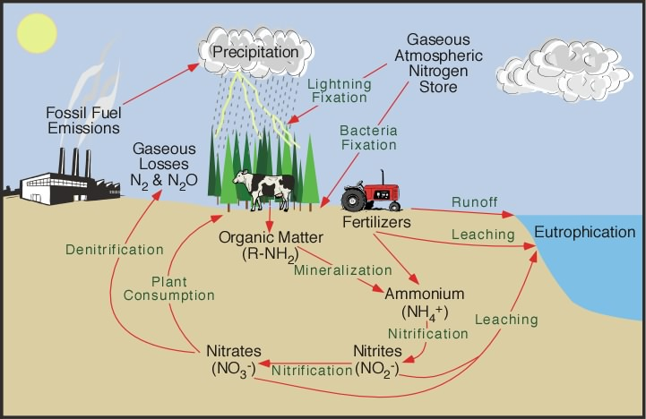
Notes:
http://orion.chemi.muni.cz/kucera/New_Folder2/nitrogen_cycle.jpg – this is a figure from a text book, but it is widely distributed on the internet, it looks like. I found it under ‘Natural Nitrogen Cycle’ google search

Slide 7
Redox ladder and sources of energy (electrons)

Slide 8
Nitrogen cycling in streams
Nitrogen is a nutrient that is important for amino acids
Nitrogen is taken up by
Algae (especially those growing on rocks)
Microbes
Microbial transformations of nitrogen can include using it as a source of energy (electrons)
USGS 2000

Slide 9
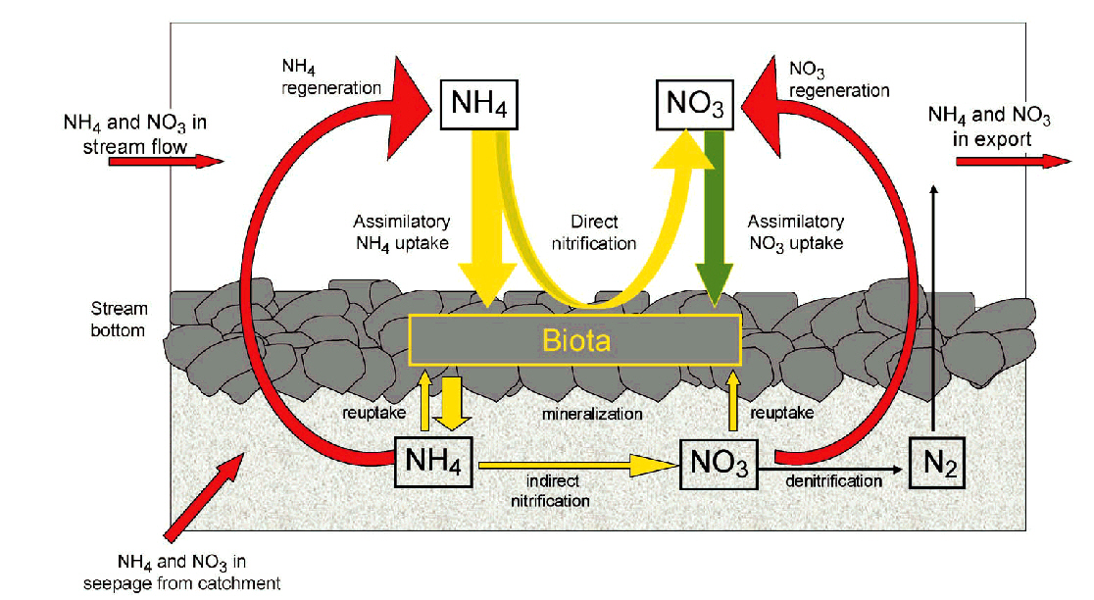
Nitrogen cycling in streams

Slide 10
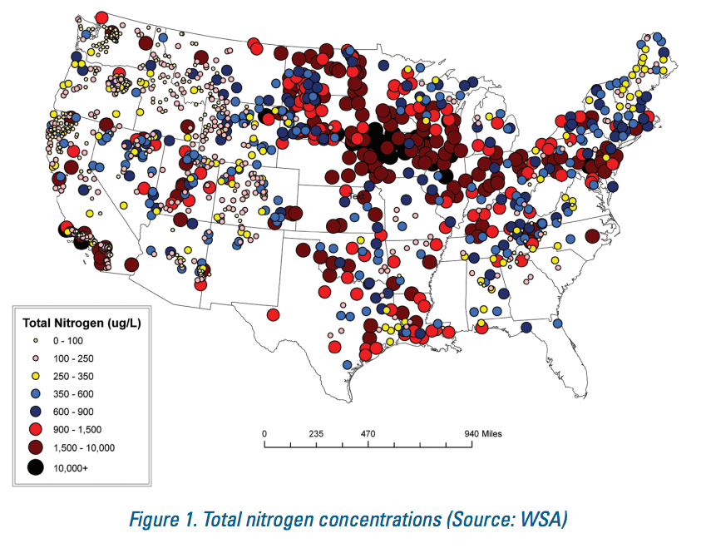
Nitrogen concentrations in streams
Wadeable Streams Assessment 2006
Notes:
https://www.epa.gov/sites/production/files/2015-03/documents/epa-marb-fact-sheet-112911_508.pdf

Slide 11
Nitrogen inputs to the Mississippi River watershed
USGS 2000

Slide 12
Sources of nitrogen in the Mississippi River Watershed
USGS 2000

Slide 13
Sources of Excess Nutrients
Fertilizer
Any material of natural or synthetic origin applied to soils or to plant tissues (leafs) to supply one or more plant nutrients essential to the growth of plants.
More fertilizer addition = Higher crop yield = More $$$
No incentive to conserve
Runoff (Non-point Source) from agricultural fields, lawns, golf courses
Waste Water Effluent
Contains excess C, N and P not used by animals
Direct input (Point Source) from waste water treatment plants and/or septic systems
Runoff (Non-point Source) from high-density animal feedlots and mega farms (cows, chickens, other)

Slide 14
Synthetic Nitrogen Fertilizers
All nitrogen fertilizers are made from ammonia (NH₃), which is produced by the Haber-Bosch process pioneered during the rise of the petrochemical industry, 1910 to 1920.
Energy-intensive process, natural gas (CH₄) supplies the hydrogen and the nitrogen (N₂) is derived from the air.
This ammonia is used to generate all other nitrogen fertilizers, such as anhydrous ammonium nitrate (NH₄NO₃) and urea (CO(NH₂)₂).
The development of synthetic fertilizer has significantly supported global population growth — half the people on the Earth are currently fed as a result of synthetic nitrogen fertilizer use.
Link: Synthetic fertilizer production-population growth-nutrient impacts
Notes:
https://en.wikipedia.org/wiki/Haber_process

Slide 15
Nitrogen yields from the Mississippi River Watershed
https://www.epa.gov/sites/production/files/2015-03/documents/epa-marb-fact-sheet-112911_508.pdf
USGS 2000
Notes:
https://ks.water.usgs.gov/pubs/fact-sheets/fs.135-00.pdf

Slide 16
Nutrient inputs lead to eutrophication in lakes and rivers
During eutrophication the lake becomes so rich in nutritive compounds, especially nitrogen and phosphorus, that cyanobacteria and other microscopic plant life become superabundant, thereby "choking" the lake with organic matter.
Eutrophication may be accelerated by human activities.
EPA

Slide 17


Plant Growth Example: Cyanobacteria
Single-celled plants that float within a water column (phytoplankton) ; previously called “blue-green algae”
Responsible for development of oxygen on Earth beginning 3.5 billion years ago

Slide 18
Cyanobacteria Blooms
“Nutrient pollution is one of America's most widespread, costly and challenging environmental problems, and is caused by excess nitrogen and phosphorus in the air and water” (US EPA)
“Blooms” are events where excessive cyanobacteria production occurs over a very short period of time. In extreme cases, this can result in a thick, green “scum” over a lake surface. which is unpleasant to look at, smells, and greatly depreciates the aesthetic and recreational value of the lake.
USGS: Cyanobacteria may form thick accumulations in near-shore areas. Binder Lake, Iowa. August 2006. Photo by J. L. Graham

Slide 19
Impact on Aesthetic Value
Visual
Olfactory (smell)
Loss of recreational value
Loss of tourist revenue
Example: Lake Atitlan, Guatemala
EPA
Notes:
https://www.epa.gov/nutrientpollution/effects

Slide 20
Impact on Drinking Water Supply
Many municipalities obtain drinking water from lakes and reservoirs
Toledo, Ohio: Lake Erie
Chicago: Lake Michigan
New York City: Catskill Reservoirs
Los Vegas: Lake Mead
The health of citizens depends upon lake and reservoir water quality

Slide 21
Impact on Ecosystem and Fisheries
Hypoxia: Low oxygen. Hypoxic waters have dissolved oxygen concentrations of less than 2-3 ppm.
Dead cyanobacteria settle to the bottom of the water column and decompose. Oxygen is consumed; process called decomposition
DOC + O₂ → CO₂
This forces fish to either swim away or die and can suffocate plants living in the water. Low oxygen water called “Dead Zone.”
Examples: Gulf of Mexico and Chesapeake Bay
EPA

Slide 22
Ocean Dead Zones
Where nitrogen-rich rivers enter the sea:
Notes:
http://www.nola.com/environment/index.ssf/2015/06/average_dead_zone_predicted_fo.html

Slide 24
NOAA Gulf of Mexico Hypoxia
Data source: Nancy N. Rabalais, LUMCON, and R. Eugene Turner, LSU Funding sources: NOAA Center for Sponsored Coastal Ocean Research and U.S. EPA Gulf of Mexico Program
Notes:
https://coastalscience.noaa.gov/research/pollution/hypoxia/ngomex

Slide 25
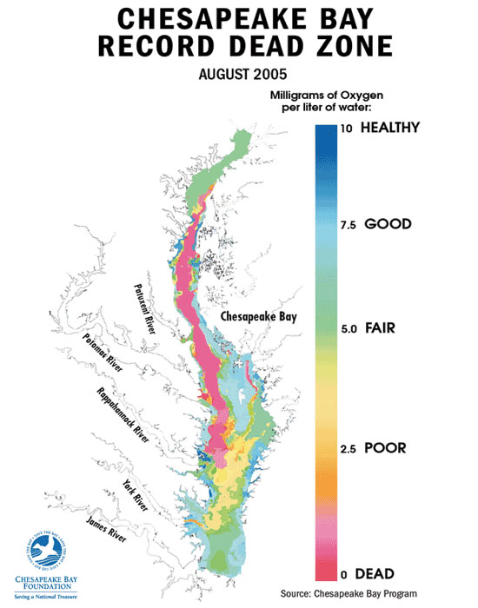
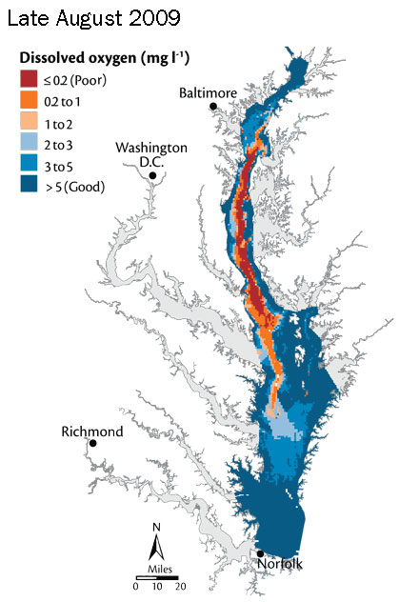
Chesapeake Bay – Largest estuary in the U.S.

Slide 26
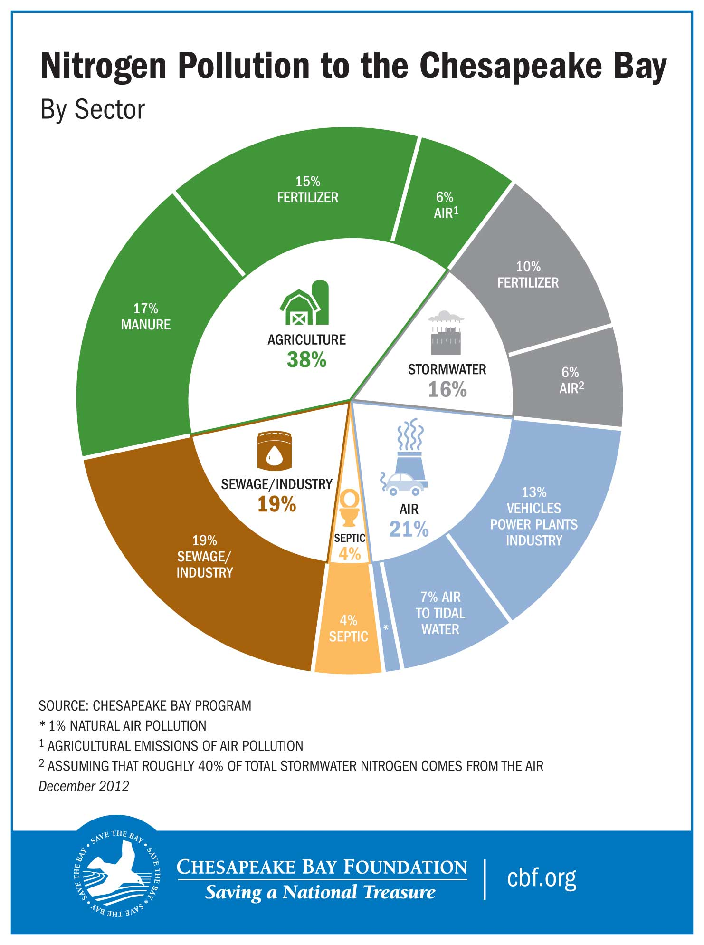

Slide 27
Which ecosystem has lower water quality?
A small stream with a high concentration (>14 mg/L) of NO3?
A large river with a low (< 0.5 mg/L) concentration of NO3?

Slide 28
Which system causes greater downstream impact on lakes or estuaries?
A small stream (low Q) with a high concentration (high C) of N?
A large river (high Q) with a low concentration (low Q) of N?
How can be best compare systems?

Slide 29
Stream Load
Mass of substance (Nitrogen, Phosphorous, Sediment, etc.) transported by a stream per unit of time
Load (M, mass/time) =
Discharge (Q, vol/time) * Concentration (C, mass/vol)

Slide 30
Management: The Clean Water Act
The U.S. Clean Water Act (CWA) is a series of federal legislative acts that form the foundation for protection of U.S. water resources:
Water Quality Act of 1965,
Federal Water Pollution Control Act of 1972,
Clean Water Act of 1977, and
Water Quality Act of 1987.
The goal of the Clean Water Act (CWA) is "to restore and maintain the chemical, physical, and biological integrity of the Nation's waters"

Slide 31
State 303(d) Lists
Under section 303(d) of the CWA, states, territories, and authorized tribes, collectively referred to in the act as "states," are required to develop lists of impaired and threatened waters (stream/river segments, lakes)
These are waters for which technology-based regulations and other required controls are not stringent enough to meet the water quality standards set by states.
The law requires that states establish priority rankings for waters on 303(d) lists
All states to submit 303(d) lists for EPA approval every two years on even-numbered years.

Slide 32
Total Maximum Daily Load (TMDL)
A calculation of the maximum daily load of a pollutant that a waterbody can receive and still meet water quality standards
The load is allocated among the various sources of that pollutant
TMDLs must also include a margin of safety (MOS) to account for the uncertainty
Predicting how well pollutant reduction will meet water quality standards
Account for seasonal variations
Under the CWA, states establish priorities for development of TMDLs from waters on 303(d) lists based on the severity of the pollution and the sensitivity of the uses
States then provide a long-term plan for completing TMDLs within 8 to 13 years from first listing.

Slide 33
Module activities:
Why is nutrient load important?
Qualitative understanding discharge-nitrate concentrations correlation
Quantitative correlation analysis
Calculate nutrient loads for a single location
Understand the impact of sampling frequency on load estimates

